Slide 1
Comets and Entropy Hydrodynamics: Does OOL Violate the 2nd Law?
Rob Sheldon
SPIE San Diego
August 27, 2013
Notes:
This has been a journey that brought most surprising results. We began in 2004 with a physics problem—how can comets possess liquid water in the vacuum of space? The solution became obvious once the question was asked. And for two years we showed how wet comets explain all the peculiar properties of comets as they travel in from Jupiter's orbit. In 2006 we even made predictions for Deep Impact and were disappointed—the s/c team targetted the hot, dry subsolar region, rather than the liquid water pools. But even then, had we the foresight to know where they would target, we predicted the “punching through” of the anomalously small crater. Itikawa was supposed to be an asteroid, but revealed itself as something other, an uninfected dehydrated comet—we think it is the exception that proves the rule. Finally Stardust returned material from a comet: clays, amino acids, cubanite, and something we didn't expect—a sand grain. Yet this unexpected grain proved that comets do vacuum up the detritus of space and can be infected in the same way. Exhausting all of our comet encounters, in 2007 we looked at where comets go, and how they prepare for the journey. In 2008 we argued that infected comets are more ancient than the Earth, filling the galaxy with information that bootstrapped life on Earth some 3.8 billion years ago. After a 2 year break, we addressed the Origin-of-life (OOL) that filled the galaxy with infected comets, arguing that the inter-connected network of comets holds more information than the mere multiplicity of comets, i.e., permutations rather than combinations can explain OOL. In 2012 we turned inward, and examined the nanometer-scale magnetites that fill infected comets, arguing that they are biological machines for harvesting energy and magnetic field. Now in 2013 we bring the large and small together, showing how magnetic fields permit information addition, how biology violates the 2nd law of thermodynamics.

Slide 2
Abstract
Information density can increase locally if one is careful to control the flow of entropy. Not diffusively but through clever use of "invariants of the flow". Replacing entropy with true invariants of the flow, we show how information can be concentrated or "added" consistent with the observation of increasing complexity on the Earth. Analogous to a digital computer made of fluid components, the "calculation" proceeds by clever manipulation of boundary conditions. Magnetized comets possess exactly the properties needed to produce the simplest entropy invariant, making them a prime candidate for driving evolution. Thus the evolution paradox can be solved, but at the cost of requiring the universe to be in a highly information-dense initial state. Such an initial state must be coherent in order to explain the information density, so that in some sense the universe began "alive".
Notes:
The 20h century began the description of physics as a huge casino, calculating the statistics of heat, of thermodynamics, and later, the probabilities of quantum mechanics. And while this description of the world has been enormously useful, providing the understanding of steel and concrete, of electricity and power, in the end it could not explain the exquisite design of bio-materials: the strength of tooth enamel, the water-repelling nature of lily pads, the low friction of shark skin. The study of these remarkable things revealed that the secret lies in their coherence, in their nanoscale structure, in their design. If the 20th century was the century of chance statistics, of bulk materials, of diffusive transport, then the 21st century has become the century of coherence, of smart materials, and of controlled transport. If the 20th century was about energy: hydroelectric dams, nuclear bombs, oil wells, then the 21st century is about energy use: wind turbines, nuclear rockets, hybrid cars. If the 20th century was about entropy, then the 21st century is about information.

Slide 3
Talk Outline
I. Motivation
II. What is Entropy? (What is Information?)
Thermodynamic & Logical (Configurational) Entropy
Shannon Information
Bridges: Boltzmann, Cold Packs, Nobel Prizes
III. What is Topological Hydrodynamics?
Physics as Geometry (1,2,3-D & Fractals) & Matter
Fluids as Matter Classical Continuum
Bridges: Invariants of the flow
IV. What is a (Entropy) Flow Invariant?
Aside: Feynman's Lectures in Physics
Scalars, Vector fields, and 1-, 2-Forms
Bridge: Gradients, Computer Clock
V. Magnetic Comets and OOL
Notes:
This talk is a discussion of the biggest problem in Evolution as viewed by a physicist— OOL, which is the violation of the 2nd Law of Thermodynamics. Indeed, everything about biology violates the 2nd law of thermodynamics, which says that over time everything should become degraded, disorganized, disordered, and dead. Biology gleefully, robustly, and manifestly violates the 2nd law so much so that physicists throw up their hands in despair. Yet even though biologists see and observe this violation, they are at a loss to explain it too.
So this talk is an attempt first to motivate biologists to consider the problem, to have physicists define entropy, to let mathematicians define fluids, to find a mathematical object that interests all 3, and then demonstrate that comets fit the bill, reuniting these three branches of science.

Slide 4
I. OOL Motivation
Notes:
Why biologists should care.

Slide 5
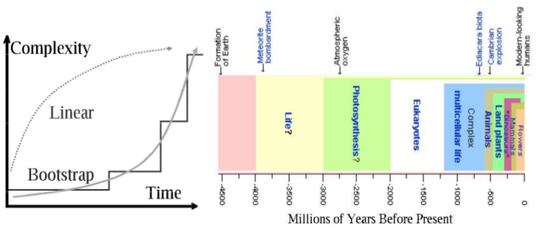
Life is exponential w/feedback
The Origin-of-Life (OOL) is a very hard problem for scientists and theologians. There is just nothing else like life—which exponentially transforms its environment by replicating itself.
That's why people thought if only we had OOL, everything else would be easy—Not.
Notes:
Darwin's theory of evolution argued that the biggest problem in the universe is going from non-life to life. Once this Origin-of-life problem had been solved, then everything else flowed down from it. When Darwin made this theory, most everyone viewed the world as he did—separated into non-living physical chemistry, and organic chemistry. Some even held that life was a fifth force, an “elan vital” that permeated organics and made them unobtainable from non-living ingredients. So it is not too surprising that Darwin simply postulated or assumed that OOL was the unexplained miracle that permitted the biome of the Earth.
As the 20th century progressed, however, it became more apparent that there was a grayscale, a gradation from prions, to virons, to viruses, to bacteria, to eukaryotes, to plants, to animals, to us, where the scale was information, or complexity. Furthermore, the scale kept getting larger and larger, as the intricacies of biochemistry and nanomachines were revealed. Plotted on the timeline are the major changes of life on this planet, and it is apparent that when scaled by complexity, the history of evolution shows an exponential rise in information.
Therefore the bridge the Darwin envisioned from non-life to life, barely registers on this complexity plot. It is a step too small to even be seen. But science (and metaphysics) would say that an effect must be proportional to its cause. How then can a step too small to be seen account for the present richness of life unless something else is involved?

Slide 6
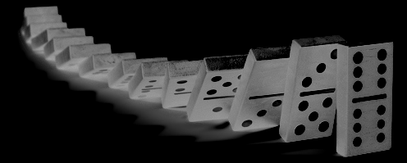
Causal chains don't work
Matter-OOL theories specify a physical causal chain leading from non-life to life, where the miracles occur at each transition. Then once Life forms, it performs its own non-linear information gathering, building on its success. These theories have failed.
They are all unlikely because, for example:
* Each species has 1000—2000 new “ORPhaN” genes without known precursor. It is not simply the 1st step of OOL, but every step is the SAME SIZE.
* But more species, so info GROWS exponentially
Notes:
It is a metaphysical truth that effects are proportional to causes. When they are not, then we must give an explanation. The nursery rhyme, “For want of a nail, a shoe was lost. For want of a shoe a horse was lost. For want of a horse a battle was lost. For want of a battle...” ends with “a kingdom was lost, all for want of a horseshoe nail.”
But is this true? Can OOL leverage Random Mutation and Natural Selection, as Darwin suggested, so as to achieve exponential growth in information? Hidden in this rhyme, however, is the hierarchy of a military machine and the special timing of a military engagement. Most of the time, a horse can lose a nail with no untoward results. It was not so much the nail, but the timing that was critical—which is to say, it was a Rube Goldberg design. But where in RM/NS do we find a comparable hierarchical design?
For example, in 2013, seven species of ant had their genomes transcribed, and were found to have 1000-2000 “ORPhaN” or unique genes with no precursor, no antecedent. This is the same amount of information as Venter's minimal mycoplasmium, suggesting that every step of evolution is as large if not larger than the first OOL step. Therefore Darwin's theory does not just need one OOL step, but an OOL step for every species, species which come at an increasing rate. But what in Darwin's theory has this property of exponential information production?
Nothing. Because in Darwin's theory, no one shares their progress with anyone else. It is survival of the fittest, and while we may have more and more organisms to search for information, they all search for it independently. The Darwinian search is linear, but the fossil history is exponential. The cause does not match the effect.
Forty years of searching for an exponential RM/NS have turned up nothing but counter-examples. Lenski's bacteria, transcribing genomes, Cambrian archaeology. Is there another solution?

Slide 7
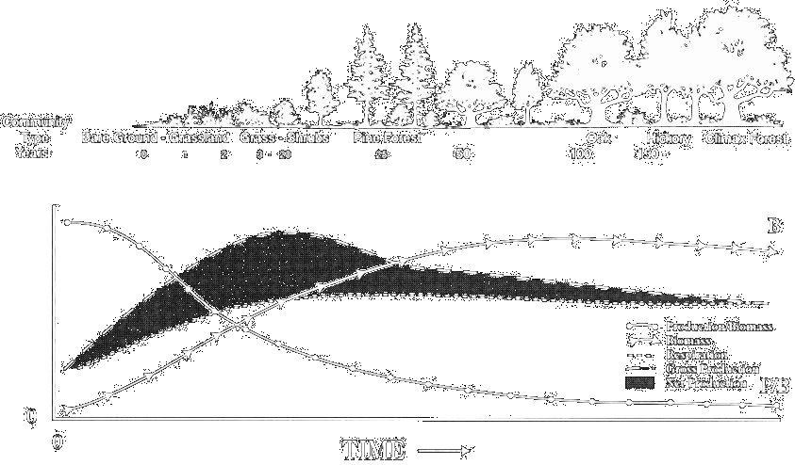
Other Types of Solutions
* If the info for a new species is NOT in the genes, but in the environment, ECOLOGY,then new species can benefit exponentially from each other.
Notes:
There are many other solutions to this puzzle of exponential growth of information besides Darwins. In the past 10 years the scientific literature has been buzzing with suggestions—self-organizing systems, symbiosis, a new physical law of complexity, the evolution of the means of evolution, multiple miracles, even panspermia. Let us analyze one of these—the idea of ecological evolution, or symbiotic evolution, promoted by Lynn Margulis and James Lovelock.
If we follow an acre of North American bare ground—say, from a forest fire—we see a progression of plants that grow and flourish there. Grasses dominate the first 5 years, to be replaced by pines in 25 years, oak in 100 years and hickory in 150. The grasses produce more biomass than they consume, and so for a while the soil is built up—which accounts for the 12 feet of prairie topsoil in Iowa. The biomass production peaks with grasses, but the biomass total does not peak until it reaches a climax forest. If we associate information with biomass, then the system continually increases in complexity even as pioneering species come and go. Globally, the system grows more complex, even if locally it decreases. And this global information is shared among species—it is the environment that stores the complexity.
So the idea behind ecological evolution, is that the system is greater than the sum of its parts. It is the system that provides the information account from which every organism draws its share. Evolution is like a bank, with information lying not only in the organisms, but between, in the connections among the organisms.
Why is this not in Darwin? Because ecological information is external, it is purposeful, it is designed. There is no a priori reason to draw a circle around our meadow and prohibit ecological information from arriving from the next state or next continent, or even next world. It suggests that life is part of a much bigger design. Darwin, on the other hand, only allows internal information.

Slide 8
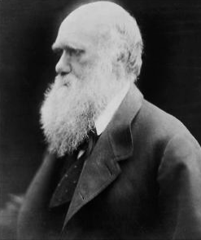
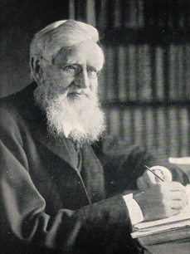
Two kinds of OOL Theory
Mechanical/ matter-driven (“hardware”)
Linear—result proportional to cause
Self-limiting. Lenz' law. Negative feedback.
NFL Theorem, Linear local search, but phase space exponential
Charles Darwin
Theoretical/ information-driven
Non-linear—result proportional to design
Self-multiplying. Positive feedback intended
Non-local, global information. Walker & Davies Exponential search
Alfred Russel Wallace
Notes:
Since there is a lot of confusion concerning Darwin's theory and all these modifications, I've attempted to compare and contrast the original, stock version of Darwinism with these new theories. Actually, they are not new, but predate Darwin! Darwin's nemesis, despite what you may have heard, was not Bishop ?? but Alfred Russel Wallace, who is grudgingly credited with inventing the theory that Darwin copied. Wallace was a firm believer in external information being essential to evolution, and wrote two books on the subject in 1903 and 1910. Particularly interesting, is that cosmologist and OOL theorist, Paul Davies has thrown in his support for Wallace in a paper published in 2013. Davies makes many of the same arguments as I do, so this is not just my analysis, but that of leading theorists in the field.
Darwin's theory assumes that information is internal to the organism—there is no teleology. Darwin argues that evolutionary progress is linear, a direct result of a material (matter-based) cause. Since progress is random, the speed of information gathering is actually sub-linear, or d/dx(info) --> sqrt(time). Recent math theorems (NFL) have proved that there is no “magic” search algorithm that always works better than linear, that genetic algorithms (RM/NS) are no faster (or slower) than a random number generator. Linear searches are self-limiting negative feedback, since any shortage of resources will linearly reduce the rate of information production—Lenz' Law.
By contrast, most of the new theories assume information can grow exponentially because the external environment can affect evolution. This means that organisms “share” information through their changed environment. Progress is now exponential, proportional to the population size. Since population is proportional to information, we have positive feedback—the opposite of Lenz' Law. Now growth is not self-limiting, but exponentially growing as resource limitations are removed by other organisms. Eg., plants make oxygen that animals need to propagate. The information then, is global, not local. And the results are not proportional to the cause, but to the cause^n power, where n = number of connections. The cause, then, is not material but informational or immaterial.

Slide 9
This Talk
But such a theory is NON-LOCAL, and shows a global pattern or teleology. It is precisely what the Matter-OOL theories can't describe, because it is not based on a mechanism, but on a pattern.
If global environment solutions exist, we need a way to describe them scientifically. (Walker+Davies 2012)
* What is the pattern? -- information
* How do we quantify it? -- negentropy
* How does it behave? -- as a topological fluid
* Is it relevant to OOL? -- magnetic comets!
The Universe as fluid computer–as cosmic carburetor
Notes:
How does one go about scientifically constructing a non-local, global theory made up of non-material immaterial causes? Isn't science only supposed to talk about material causes and leave the immaterial stuff for religion and UFO kooks?
The answer may surprise you, because science has always dealt with immaterial things—beginning with conservation laws, the equivalence of energy, and ending with information. It is from the science of thermodynamics that we develop the concept of entropy and its obverse—information. What makes science “scientific” is not the character of the causes, but the character of results. Science is quantitative and predictive, science requires that causes match effects. Science looks for patterns. Science is all about information.
Information, it turns out, is the opposite of random, the opposite of local, the opposite of internal. Information is a pattern, it is global, it requires an external context. That is, you may not be able to tell the difference between a file filled with random noise and one with a zipped program, but run on the right hardware, the zipped file will turn into glorious information. Thus information always requires a context, an external interpreter.
This paper then, explores the first baby steps of constructing a non-Darwinian, or post-Darwinian evolutionary mechanism based on information. We must learn how to quantify information, how to transfer information, and finally, how to add information (for any fool can subtract it!) We follow in the footsteps of the masters when we assume that information is a fluid, whose transport must be conserved. Addition, therefore, is akin to making a computer out of fluid, just as a carbeurator calculated the right fuel-air mixture for the engine. As in earlier presentations, we think comets are the information carrier of the universe. In a nutshell then, we are engaged in an effort to describe OOL as the result of a cosmic carbeurator powered by magnetic comets.

Slide 10
II. What is Entropy?
Notes:
A seriously misunderstood topic.

Slide 11
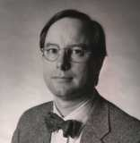
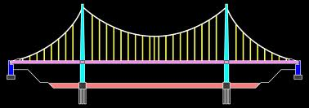
Kudos to Klyce
Thermodynamic
Carnot, Clausius, Kelvin
Heat ==> Work
dS = dQ / T
2nd Law: dS >= 0
“no perpetual motion”
Negentropy, Logical
Shannon, Davies
Channel ==> Signal
I = -ln S = p log p
dS = 0
“no free lunch theorem”
S = k ln Ω
Boltzmann
Notes:
When the steam engine was invented in the 18th century, there were many improvements that enabled it to provide more work with less coal. The improvements were so significant, that many people devoted their life to making better and better engines. Indeed, some thought it was possible to make an engine that consumed no coal, but provided infinite energy out of nothing.
To answer these questions and claims, physicists of the 19th century began to develop a terminology or science of heat engines, which is now called thermodynamics. By considering an ideal gas (instead of steam) Sadi Carnot showed that an engine cannot simply turn all the coal heat into work without wasting some, because there was a special quantity that stayed the same or increased, which he called “Entropy”. Entropy measured the “quality” of the heat energy, with higher temperatures being higher quality. You can make a heat engine with a 800 C fire, but it is a lot harder with 40C bath water. In symbols, this is was: dS = dQ/T. Building on Carnot's insight, other physicists such as Clausius and Kelvin developed the “3 Laws of Thermodynamics” expressed in many ways: No perpetual motion, No perfect refrigerators/engines. The 2nd Law is often stated that “Entropy must either stay constant or increase”.
The reasoning was rock-solid. If any of these laws were violated, we'd all have infinite energy for free. And since engines need energy, such a person would become infinitely powerful—a property usually reserved for God! All this was established by the middle 19th century when along came the atomic theory of matter.
In 1890 Boltzmann used the atomic theory of matter to argue that entropy was related to counting the number of ways to arrange the hard-sphere atoms of an ideal gas. This converted an experimental fluid (albeit immaterial), into a statistic, into a number, into a counting exercise. Suddenly the entire field of immaterial mathematical statistics took on a physical meaning. Not only so, but in 1930 Claude Shannon argued that these same statistics controlled the way AT&T could send messages along telegraph wires. He reused the word “entropy” to describe communication, and gross confusion reigned to the dismay (or merriment) of all. Brig Klyce has a nice blog page helping sort things out.

Slide 12
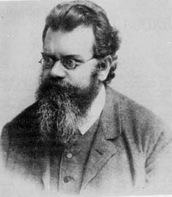
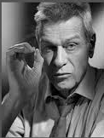
Boltzmann's Bridge
Boltzmann's k
S = k ln Ω
“k” Strictly speaking, applies only to ideal gasses—perfect spheres bouncing in the void. It is EMPIRICALLY determined!
What drives an endothermic reaction? Increasing Entropy.
Nobel 1991: PG de Gennes: soft matter “k”:
“a random walk that never intersects itself” -- 100 years later we have LCD displays, not OOL!
Notes:
The field of thermodynamics is well-established, as is the field of mathematical statistics. The thin, wobbly bridge connecting these two completely unrelated regimes is Boltzmann's famous equation, engraved by his request on his gravestone: S = k ln (W). On the left hand side is S, a thermodynamic quantity, and on the right hand side is W, a mathematical quantity. Between the two is “k”, or “Boltzmann's Constant”, which converts one to the other.
Boltzmann never calculated k. He merely stated its existence. That's because it isn't a theoretical unit, it isn't based on ratios of h, c, pi or alpha. It is empirically determined with some sophisticated apparatus measuring the speed of sound in a fluid. If we change the fluid, we need to change “k”. And if the fluid is really complex—say a protein solution, or the insides of a cell—then we really have no idea what to use for “k”.
We know it is there, because entropy drives many chemical reactions. The chemical cold packs that dissolve NaNO3 in water and become very cold are an example of a reaction driven by the greater entropy (randomness) of the dissolved salt that compensates for a negative dQ/T. Nevertheless, for truly complicated chemical reactions, we can't calculate dS because we don't know what “k” to use.
For example, in 1991, a full 100 years after Boltzmann's invention of “k”, PG de Gennes received a Nobel Prize for calculating “k” for long, slippery molecules. Many more Nobel Prizes await those who can find the “k” for living cells.
The consequences of this ignorance are profound. It is impossible to convert the mathematical S of, say, amino acid sequences into a thermodynamic S. We cannot explain how life comes by its organization by examining the entropy of sunlight. We cannot even explain the entropy difference of a live versus dead cell. All we know is that mathematical information (negative logarithm of mathematical S), is enormous for living things, and that the laws of thermodynamic S should apply to biological information as well. This leads us to Claude Shannon's insight.

Slide 13
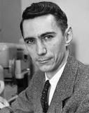
Shannon Information
The simplest of the many ways to calculate Ω.
But not the only way to measure info:
a)We can add multiple dimensions, fractal dimensions to Shannon's binary calculation.
b)We can add characters—self-unpacking libraries.
c)We can add external information—bootstrapping.
We can run through (a) – (c) multiple times
There IS no local limit to info – only global limits.
But how can info increase, if dS > = 0?
Notes:
Claude Shannon, while working for Bell Labs, realized that the noise on telegraph lines that hindered transmission was random, whereas the transmission was ordered. This was precisely the way Boltzmann had described entropy of ideal gases. So Shannon proposed that the “bits” (he coined the word, as well as invented the first electronic computer), were like atoms, and their behavior was similar to adding heat to atoms. By thinking of the noise as “all the arrangements that mean nothing”, he could define information as I = - (S) = - (k ln W) where he set k = ln(2) for binary systems. Then “all the arrangements” became p! (p factorial), which in Stirling's approximation is written: ln(p!) ~ (p ln p – p). This means information ~ - p ln p.
Many systems can be analyzed using this formula, including peptide sequences in proteins, or DNA codons themselves. But this is not the maximum amount of information in a system. Among other things, it assumes a binary encoding system, a fixed alphabet, and a n-dimensional “rearrangement space”. If we change basis to base 20, or allow the system to redefine its alphabet, or add dimensions, we can get more information than this simple measure. For example, people talk of “kolmogorov information”, or “algorithmic information”, which is the shortest program that can produce the same output. That is, a million digits of pi have a huge amount of Shannon information, but a tiny program can generate them, so it has little algorithmic information.
Thus Shannon information is not the MAX but the MIN amount of information in an arrangement. Nevertheless, we expect the 2nd law of thermodynamics to hold for whatever kind of information we are discussing: deltaS >= 0.

Slide 14
Info Summary
Without a bridge, we cannot inter-convert logical and thermodynamic entropy.
We cannot explain OOL in terms of thermodynamic entropy, despite Boltzmann's bridge.
We cannot even find an upper limit to the information involved in OOL—only a lower limit.
We can only conserve SEPARATELY the logical and thermodynamic entropy. [Granville Sewell 2013]
(But better than physicists generally concede, when they cry “Open System, Open System!”)
Notes:
To summarize:
a) The information of OOL cannot be collected from sunlight, radioactivity, clay minerals or any simple thermodynamic system, because we can't interconvert thermodynamic S to informational S for biological systems without a “k” (Or even if we could, the informational k* >> k making sunlight useless.)
b) We cannot even explain mathematical or “logical” information in terms of thermodynamic entropy, despite Boltzmann's bridge, because logical entropy always involves things more complex than billiard-ball ideal-gas atoms.
c) We cannot even put an upper limit on the information involved in OOL simply because a larger system, say, a coacervate inside a gene machine, introduces far more external information. Even without the external influence, a OOL system incorporating recursion can potentially have infinite information. At best, we can find a lower limit to the amount of information in an OOL system.
d) Therefore, the 3 laws of Thermodynamics apply to informational S separately from thermodynamic S. It is as if there are many different types of S, each one conserved and individually obeying the 3 laws of thermodynamics. This was Granville Sewell's paper in 2011/2013.
e) While this non-inter-convertibility is a major barrier for “metabolism-first” or “coacervate” or “clay-mineral” approaches to OOL, it still tells us more than the common physicist excuse “No laws of thermodynamics apply to open systems.” The physicist deals with open systems all the time, and can apply standard conservation laws to them, namely “time rate of change = amount crossing the boundaries of the system + internal sources/sinks.” This is Sewell's conclusion, and the basis of all hydrodynamics. If we can describe this flow, then we can isolate sources/sinks from transport of information.

Slide 15
III. What is Topological Hydrodynamics?
Notes:
An old, but rapidly developing field of applied mathematics.

Slide 16
Physics as Geometry over Matter
Newton's Laws are all simply conservation of particles and energy.
Maxwell's equations are geometric requirements for conservation of charge, energy and momentum.
Thermodynamics has its own rich terminology that turns out to be just the conservation energy expressed geometrically.
Physics is simply Stamp Collecting + Geometry!
It just isn't plane geometry, it is curved, Differential Geometry applied to the continuum.
Notes:
In the 18th and 19th century, Newton's laws were expressed in differential calculus, and the fields of celestial mechanics and analytical mechanics were developed. For example, the energy available for use, Kinetic – Potential, was entitled the “Lagrangian”, and spatial derivatives of this quantity resulted in Newton's Laws. By contrast, the total energy, Kinetic + Potential was called the “Hamiltonian” and led to energy conservation and wave equations. In the early 20th century, Emmy Noether showed that these two bookkeeping methods were measuring the same thing, which turned out to be the symmetries of the system. Whenever something is conserved, say angular momentum, it means that there is a geometric symmetry, say cylindrical symmetry, associated with this quantity.
Noether's theorems, then, reduce physics to the set of geometrical symmetries of the system combined with some conserved quantity—energy, mass, etc.
Thus Maxwell's equations turn out to be geometry + charge, Newton's laws are geometry + mass, Thermodynamics are geometry + energy.
Ernest Rutherford said “only physics is science, everything else is stamp collecting” but via Noether's theorems, physics turns out to stamp collecting with geometry. But this isn't your grade school plane geometry, it is geometry on steroids, it is differential geometry—the description of curved surfaces and flows.
Our goal, then, is to apply these insights to information, so that the physics of information = geometry + entropy.

Slide 17
Fluids as Classical Continuum
Geometry is Continuous. Like Aristotle's matter and Clausius' S.
Atoms are discrete, and follow counting statistics. Like Boltzmann's S.
At global scales, or at even cellular scales, Boltzmann's bridge fails, we cannot compute Ω and we fall back on a continuous, FLUID approach to entropy S.
In the fluid approach, it is the FLOW that we measure.
Problem: “No man ever steps in the same river twice.”
Heraclitus, circa 500BC
Notes:
The first problem we face in this task, is to find a representation of entropy, S, that can be described by geometry. If our quantity is discrete, like atoms or p! arrangements of atoms, then we cannot easily use geometry. Geometry, like space and time and flows, is generally taken to be continuous. Aristotle also viewed matter as continuous, and therefore capable of a geometric interpretation. This is why Clausius' entropy was a continuous fluid.
Atoms, however, are discrete, and follow counting statistics such as Boltzmann's S. The real power of quantum mechanics comes from converting atoms into waves so that they can then be treated as a continuous material. Possibly the resolution to our conundrum of representing atoms w/entropy is quantum entropy, but for our limited exploration, we use classical, continuous entropy.
This is not such a bad approximation because biological information is so very large, that we do not expect its discrete components to be observable. Therefore the important aspects of entropy are not its origin in the p-permutations of biomolecules, ~pln p, but rather its flow into and out of the control volume.
This brings up the 2nd problem. How do we handle the flow of entropy?
As Heraclitus said some 2500 years ago, “no man ever steps in the same river twice” for the river has changed and so has the man. If entropy is a river, how can we ever control it or calculate with such liquid assets. Is it possible to concentrate the flow of entropy to get OOL?
Yes, but it will involve invariants of the flow, topological changes to the flow geometry like knots that are local representations of global changes.

Slide 18
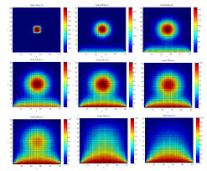
Bridges: Invariants of the flow
Some things in the river, stay the same:
*The number density.
* The net momentum.
E.g. “invariants of the flow”
Other things change:
* flow velocity
* the entropy
Problem: Fluid entropy is more like temperature-- it changes. Is there an invariant with Entropy?
Yes! It is a Topological Invariant.
Notes:
Some things in a river are conserved. If we watch the fish in the river (over a short period of time) they don't multiply or vanish from our imaginary box, but they swim in one side and out the other, their number is conserved. We could say the same for the mass, the same amount of mass flows in upstream side as leaves the downstream side.
On the other hand, other things in the river are not conserved. Temperature fluctuations can enter and diffuse away, light can flicker and be absorbed. Speed or velocity can be high on the upstream side, flow over a waterfall and be slow on the downstream side.
Does entropy act like one of the conserved quantities or one of the non-conserved quantities? Since dS = dQ/T, it behaves more like heat or temperature. And heat and temperature obey the heat equation—they diffuse away from an initial sharp boundary. The inset shows how a pulse of heat behaves, and entropy behaves similarly. Then directing entropy is like herding cats. (Since the units of S are J/K, but lack a SI name, I hereby propose to call this unit a Hobbes. Then Kelvins * Hobbes = Joules.)
Then is it true, as is commonly believed, that all systems diffuse their information away, that increasing entropy is inevitable, that there is no way to reverse the degradation of time and circumstance? While this may be true of inanimate objects, biology defies the ravaging of time and the diffusion of information. So it must be possible to control the flow of entropy.
The answer is found in topological invariants of the flow. If temperature or heat is not invariant, then we must find a structured flow that involves entropy.

Slide 19
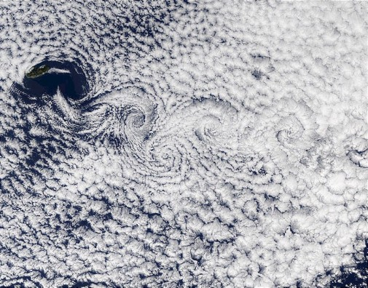
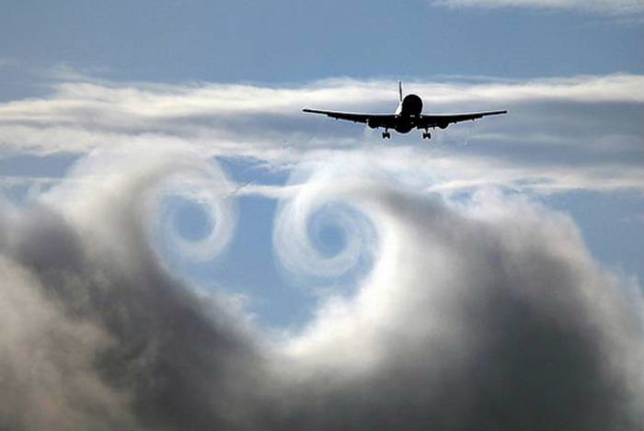
Vortices
Clouds CanaryIslands
Wingtip
vortices
Notes:
We already know of structured fluid flows that do not decay away like heat or temperature. They represent a “knotted” topology of the flow, and are called vortices.
Here are three examples of vortices. The left panel shows vortices in the atmosphere as revealed by satellite photographs of the clouds downstream of the Canary Islands. The vortices alternate in polarity and form a “vortex sheet” or “vortex street”.
Airplanes also create vortices that curl off the wingtips. This can be visualized in the bottom panel that shows an airplane flying through the top of a cumulus cloud. Notice that the vortices are of opposite polarity. The right panel shows the four engines of a jet airplane leaving steam trails behind them, where two trails on each side twist around each other as the wingtip vortex entangles them.
Some observations:
a) Vortices are made out of a fluid. No special ingredients. No extra properties.
b) vortices appear to come in + and – versions. They appear to be binary, where the sum remains zero. This can also be observed in the vortices leaving a canoe paddle in still water.
c) Vortices are long lasting. They do not diffuse away at the same rate as other fluid properties. Notice how the clouds are distributed randomly, with short-term disorder, but the vortices remain coherent for hundreds of miles. Ditto for the jet contrails, where the steam diffuses, but the vortex remains.
Therefore vortices in a fluid can possess “digital” properties by nature of their topological invariance—they can perform the function of Shannon's bits.

Slide 20
IV. What is a (Entropy) Flow Invariant?
Notes:
A brief excursion on math.

Slide 21
Scalars, Vectors etc
Scalar has only size, no direction:
Vector has size & direction:
Matrix (dyadic) has size + 2 directions:
3rd rank Tensor has size + 3 directions:
4th rank Tensor: in differential geometry ==> 0
Some operators, like gradients, increase the rank
Other operators, like divergence, decrease the rank.
Yet others, like curl, do both. [Webb et al. 2013]
Notes:
This is a very brief introduction to some properties of differential geometry. Like the plane geometry taught high school, differential geometry has a subject matter that it manipulates, only it isn't triangles, parallel lines and polygons, it is scalars, vectors and dyadics and tensors. Or to simplify the jargon, scalars=0-forms, vectors=1-forms, dyadics=2-forms and tensors=3-forms (we don't distinguish them from vector spaces right now.) There are no 4-forms because we live in 3-space.
Some operations move objects toward higher dimension. Perhaps you are familiar with a gradient operator that converts a scalar topo map into a vector map with little arrows pointing in the downhill direction. So gradient (0-form) --> 1-form. It raises the dimension. Likewise there are operations that collapse dimensions. The scalar product, or contraction, takes two 1-forms and produces a scalar. So (1-form * 1-form) --> 0-form.
We can generalize the gradient to be an “outer derivative” that can operate on any size n-form, but when we operate on a 3-form, we always get zero. Or as John Wheeler once explained Einstein's equation: “the boundary of a boundary is zero”
The power of differential geometry, is that we can put in some 0-form, such as energy, and derive 1-forms (forces), or 2-forms (stress-tensors) simply by carrying out geometric transformation, so that all of Newton's Laws and much engineering can be obtained simply from the conservation of energy. Not only is it a powerful way to derive the physics, it is a powerful way to find topological invariants that greatly simplify the solution of a problem. Such as my freshman nemesis—an Eskimo slides off the top of his frictionless igloo, where does he go airborne? Solving was devilish using Newton's vectors, but was trivial using scalar energy conservation. The lesson I learned was that one should use scalar conservation laws wherever possible.

Slide 22
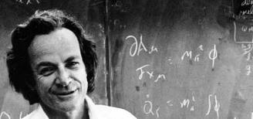
Aside: Feynman's Lectures
Physics is always taught beginning with forces ---> conservation laws: Newton's 3 Laws of Motion.
Problem: one has to learn vector addition (and multiplication) to master the 1st semester!
Result: fewer and fewer Physics majors.
Richard Feynman attempted to start with Energy conservation. Energy is a scalar. It adds just like a number. Only later do we take the gradient to find dE/dx = ∇E => Force!
Every student has his 3 vols. No one teaches from it.
Notes:
I was not the first to make this discovery. Nobel prize winner, Richard Feynman decided to teach his undergraduate physics course at CalTech using a scalar approach.
Now understand that for 100 years, every physics student starts the semester learning Newton's 3 Laws of motion, and has to master the art of adding and subtracting and multiplying vectors. As the year progresses, he even has to master the 2-forms of rigid body mechanics. Only much later does he learn about energy conservation and perhaps in his 2nd or 3rd year, the Hamilton's equations of motion. This steep learning curve has the unfortunate consequence of scaring off many potential physics majors.
Feynman decided that rather than starting with Newton's Laws in the first week of class, he could introduce the scalar energy and demonstrate its conservation. Since gradients of the energy are forces, then with a bit of differential geometry Newton's Laws fall out naturally (rather than being taught as gospel.)
Lore has it that the class soon emptied of undergraduates (who had all undoubtedly taken AP physics in high school and could not grasp his approach) but their seats were soon filled with graduate students and other instructors. The lectures were published in 3 volumes, and every graduate student has them on his shelf.
Why did Feynman fail? I think it was because Newton had been taught to bolster a materialist, atomist world view, and the metaphysical implications of an energy-dominated universe were too foreign. Feynman just didn't reach them young enough. But if we do not shrink from differential geometry, we can learn a lot as well.

Slide 23
Cut to the Chase: “Ertel” Invariant
Ie = B • ∇S / ρ
where B = vector magnetic field [Webb et al 2013]
∇S = gradient of the scalar Entropy (vector)
ρ = the density of the fluid (scalar)
But, B can also be written as a vortex: B = ∇×Α
Where A is the “magnetic vector potential”
The Ertel invariant is a scalar that doesn't change with the flow: It is a topological invariant, like a vortex.
It contains not simply Entropy, but grad S. And B.
WE CAN CONCENTRATE ENTROPY
Notes:
While it is possible to use differential geometry to demonstrate how this variation on the Ertel invariant not only is invariant: dIe/dt = 0, but it is a “topological charge” giving a non-zero result when integrated over a closed path, we refer you to Webb et al. 2013 for these results.
Note that the Ertel invariant was derived for hydrodynamic flows, not for magnetohydrodynamic flows. Therefore instead of magnetic field B, it uses vorticity, w = curl(u) where u = fluid velocity vector. Since B can be written as curl (A) where A=magnetic vector potential, we have substituted one vector field for another in the equation. From a geometry viewpoint, this is perfectly valid, since A is defined in all the same way as u. For lack of a better label, it is the magnetic Ertel invariant, or the Webb invariant for short.
Note also that this Webb invariant is a scalar. That means it can be simply added or subtracted without having to take into account directions of flow or magnetic field. Like Feynman's lectures, this makes it a fundamental property of the fluid from which all other laws can be derived.
Note that it involves the gradient of entropy, grad(S). Therefore adding and subtracting Webb invariants, involve adding and subtracting entropy as well. But rather than diffusing away, the Webb invariant is topological, it acts like a fluid vortex that does not diffuse. So we are adding and subtracting entropy with digital precision.
Finally, note that the scalar is formed by a contraction of B*grad(S). The invariant is proportional to the strength of the magnetic field. There are dissipative terms in a fluid that remove w=curl(u), but B can be non-dissipative: collisionless plasmas or permanent magnets. Both can be positioned exterior to the volume of the Webb invariant, so they do not necessarily participate in the entropy gradient, but they permit the existence of this topological quantity.

Slide 24
V. Origin of Life & Magnetic Comets
Notes:
The application

Slide 25
Thermodynamic Constraints
Darwin thought OOL would occur in a warm pond.
But heat would destroy the low-entropy precursors.
It would also diffuse the reactants away.
It would be far more better to use a cold pond, and rely on catalysts to increase the reaction rate.
In fact, a frozen pond is even better, because diffusion goes --> 0.
Note how the Webb invariant depends on ∇S / ρ
Notes:
As described in our previous SPIE papers in 2004, 2005, 2006, 2007, 2008, 2011, 2012, comets contain liquid water and ice, grow cyanobacteria (and now diatoms!), and form biomagnetites. Now with the Webb invariant, we are in a position to compare the properties of comets with the ingredients for a large invariant, that hopefully will allow us to add information and OOL.
First, we contrast comets with other suggestions for OOL. Almost all other models have followed Darwin's suggestion of a “warm pond”, hoping that the higher T will promote the “life” reactions. However, looking at the Webb invariant, T is our enemy and not our friend, since it diffuses S and destroys grad(S). John Sanford has also argued that even after OOL, entropy remains the enemy of information. On the other hand, solid ice doesn't flow very fast. So ideally gradient(S) will be a maximum on the interface between ice and liquid water.
Second, note that the Webb invariant is inversely proportional to density. Then larger gradients are possible when the density is also large. Water has one of the largest densities of comparable liquids, and reaches its peak density at 4C, very close to the water-ice interface. Once again, warm ponds dilute the entropy gradients away from the maximum.

Slide 26
Geometric Constraints
Darwin thought a warm pond, was big enough for the local mechanical, matter-OOL theory to work.
But if ΔS =0, there is not enough local information!
We need a global system, a coherent system, a system that can concentrate information. (Walker & Davies 2012)
Notice how the Webb invariant involves topological or global invariance involving B.
Notes:
Darwin also thought that a warm POND had sufficient resources to begin life. For example, one can look at the elemental composition of a cell, and the elemental composition of fresh water (or sea water), and then extrapolate to how much water had to be collected to provide all the elements necessary for life. A slightly more sophisticated model might look at likely molecules that carry those elements. For example, most carbon molecules are insoluble, so CO2 dissolved in water is the most likely source of carbon. From these sorts of considerations, and assuming some mechanism to concentrate phosphorus, one extrapolates to a pond-sized body of water. Undersea vents have some advantages over ponds for some elements, but not for others, leading to tradeoffs and increasing unlikely “concentration” events.
The key word is “unlikely” which is to say non-entropic, or informational. All these locations must possess information, and in large quantities. (Remember, we can't interconvert information, so it is not possible to simply invoke a low entropy energy source!) Furthermore, the information is not collected all-at-once, but like most organic compound syntheses, appears in multiple steps. In other words, our location must have enough information to collect, and there must be a way to progressively add information. Neither of these conditions apply to a warm pond, and while an undersea vent has a continuous flow, its high temperature precludes the adding of information via the Webb (or Ertel) invariant.
What we need is a global system, that like the undersea vent, continuously brings in information to be added to the system. This is also the conclusion of Walker&Davies 2013. And between “adding events” information must be preserved against degradation—much as an organic chemist purifies his reaction products before starting the next reaction.
Comets fulfill these requirements, since between close encounters with a star, they freeze to 5K above absolute zero. While when melted, they supply maximum gradient(S) at maximum rho.
But what about the B-field of the Webb invariant? Do comets possess B?

Slide 27
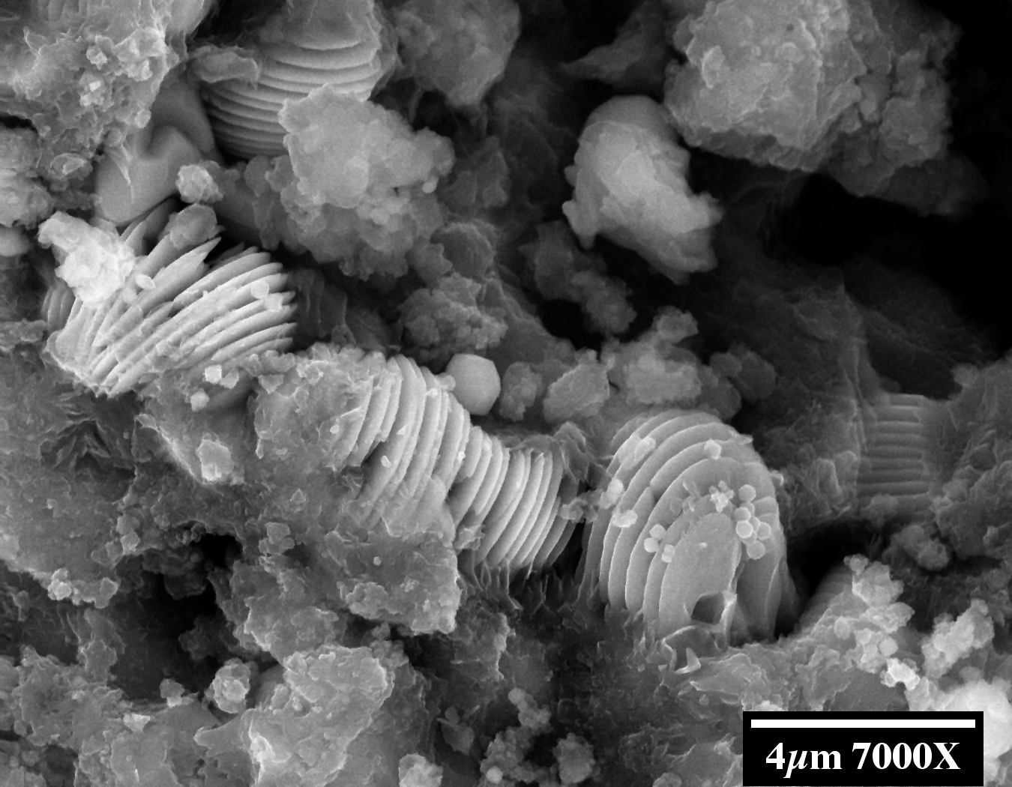
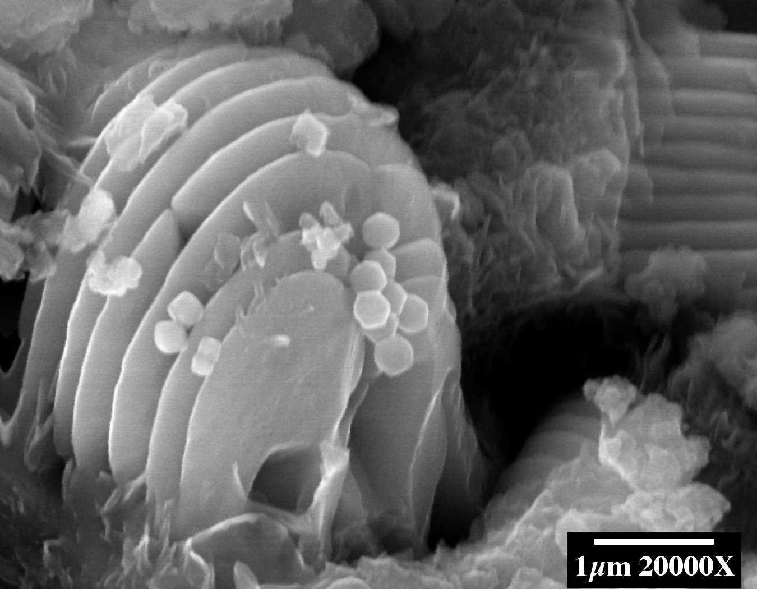
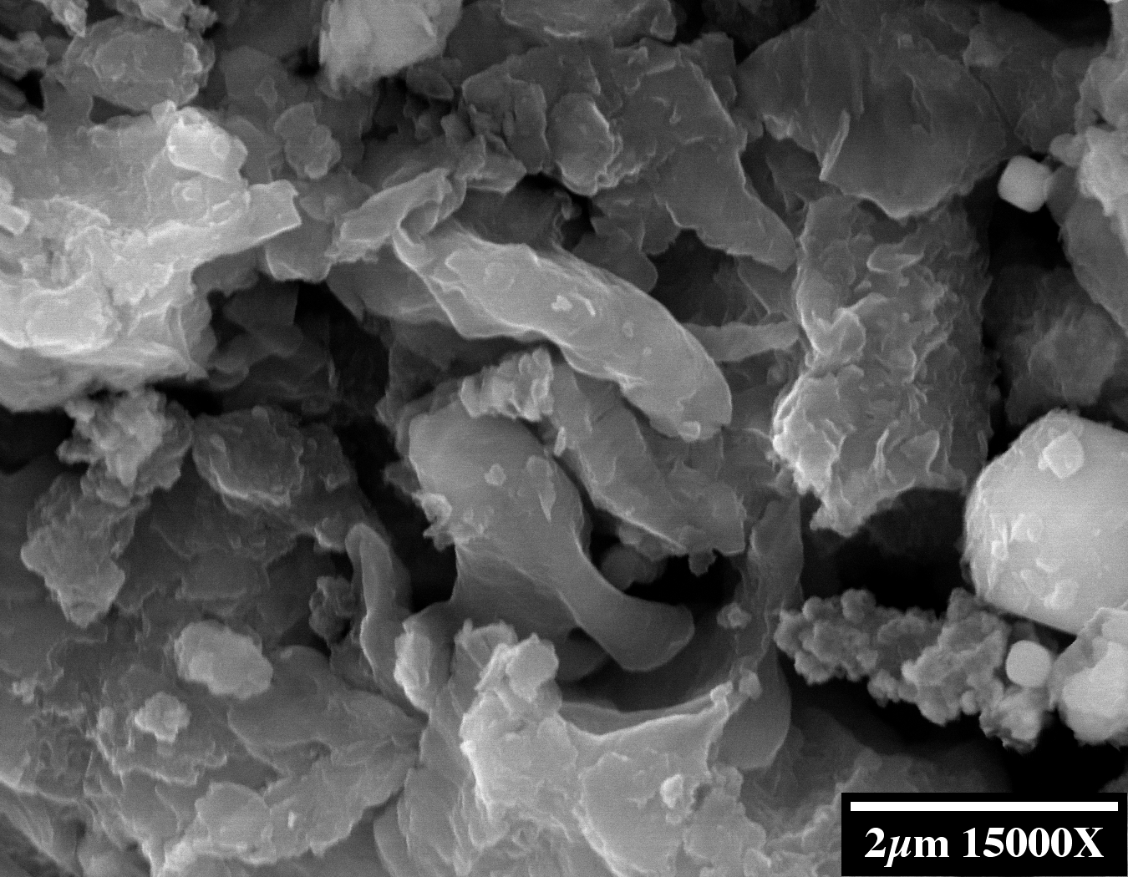
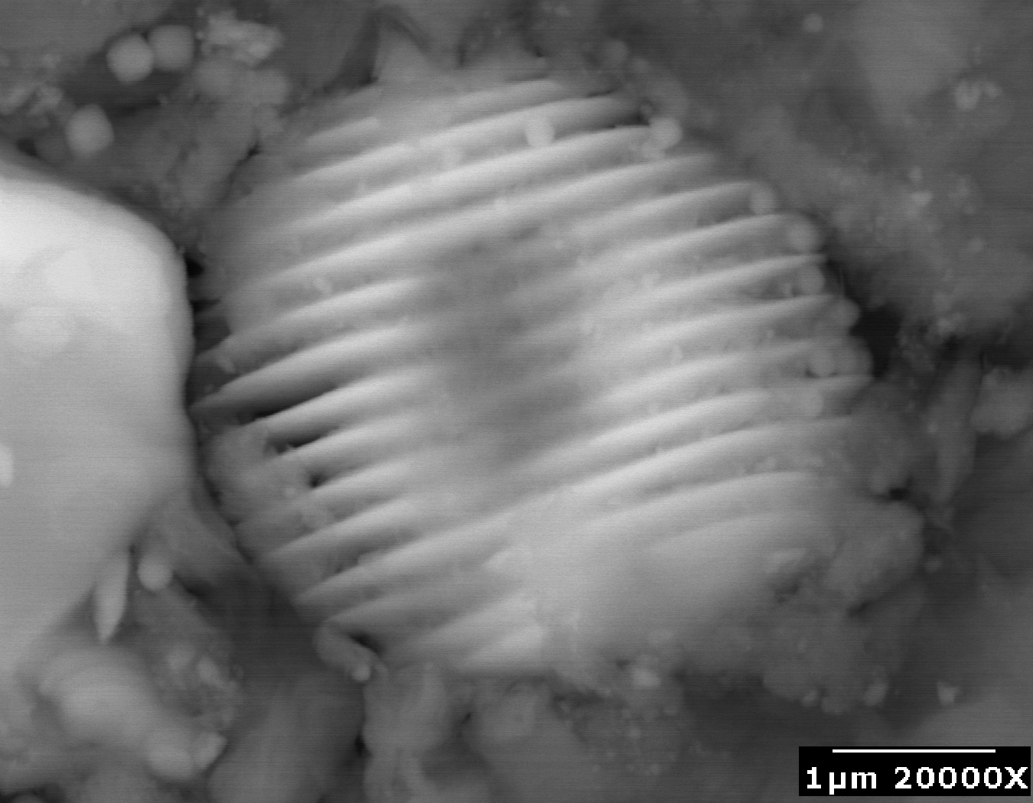
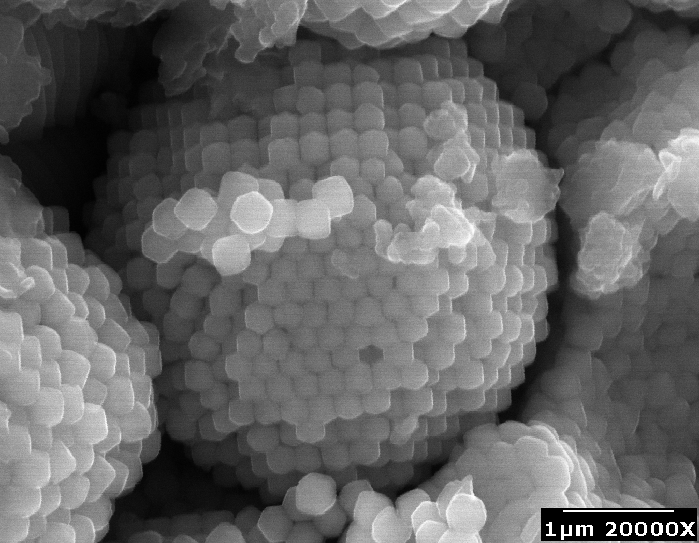
Bridges: Magnetic Comets
Hoover 2012
Notes:
But infected comets are magenetic! In our 2012 paper we describe the many forms of biomagnetite and discuss how they can set up magneto-thermal convection and harvest interplanetary magnetic field. In this slide on the lower right we show “framboids” or balls of ball-bearings, which we argue are supremely sensitive paramagnetic bodies that engage in thermo-magnetic convection. At the same magnification scale on the left is a “plaquette”, a ball of platelets that we could not find a function for but suggest they bore more than a passing resemblance to chloroplasts. We hypothesized that they may act as energy harvesters for growing cells.
Now that we have the Webb invariant, we can apply the previous analysis to the consideration of B*grad(S). The magnetic field is clearly normal to the platelets. The spherical shape of all these structures enable them to align with the external B-field and so maximize their contribution to the Webb. To further maximize the Webb, the grad(S) must also be perpendicular to platelets. In these fossilized forms, we can only see an organic sheath around the entire ball (and holding it together), but presumably each platelet also had an organic layer on which chemical reactions could proceed, maximizing the surface area.
Since Fe3O4 has the ability to split H20 into H and OH, it would appear that these devices may be functioning as chloroplasts, driving high entropy CO2 to low entropy C(H2O), or concentrating information. As weak support, the Oxygen triple isotope ratios are also BELOW the terrestrial (evaporational) fractionation line, appropriate for chemical reactions occurring near the freezing point of water.
Thus it would seem that magnetic comets utilize the Webb for carrying out the chemical reactions for life.

Slide 28
Comets Harvest B-field
1. A spherule rotates with the crust
2. At subsolar point it heats to Curie point
3. It cools and grabs the fieldline, wrapping it around the comet—harvesting B-field
4. Crust becomes highly magnetized like ram valve water pump
2
1
1
3
Notes:
While self-organizing paramagnetic Fe3O4 can spontaneously generate magnetic field, its strength is limited by the magnetic permeability (or is that permissivity?) of magnetite. In addition, once all the Fe on the comet is used up, there is no further increase in field. However, comets travel through the magnetized plasma of stellar winds, and they can concentrate and collect these fields as well. In terms of total energy or volume, the interplanetary field can be much larger than the internally created field.
But in reality, they are synergistic. The interior field is randomly oriented, whereas the external field is global, so the exterior field will align and “magnetize” the random internal fields. In return, the interior fields will “trap” and harvest the exterior field, as described schematically on this figure.
Therefore a comet will become more and more magnetized, particularly as it approaches a star and begins to melt. This is precisely the time when the liquid needs to conserve the Webb, and so magnetized comets are ideally structured to maximize and add information.

Slide 29
Conclusions

Slide 30
Comets Carry Webb Flux
Theoretical Reqs
Low T
Large ∇S / ρ
High B
Large velocity (global reach)
Fluid approximation
Empirical Observations
99% of time T< 10K
Frozen/liquid boundary
Magnetites!
Hyperbolic Orbits > 30km/s
More than 1 trillion in our Solar System alone
Comets have met all the requirements for concentrating information from the Universe -> Earth, which “violates” the 2nd Law via entropy addition.
Notes:
Summarizing this application of the Webb to magnetic comets:
Entropy gradients must be preserved to maximize the Webb, which is achieved by barely melting a comet for each information addition, and then refreezing it for the next addition.
Entropy gradients are further maximized by operating at the ice-water interface where water has its largest density. In the case of plaquettes, operating at the Fe304 – water interface also maximizes the gradient.
Magnetic field must be large to maximize the Webb, and magnetic comets use both internal paramagnetism and external interplanetary B harvesting to magnetize their interior.
Information must be collected globally if there is to be any hope for OOL. Comets not only move freely throughout our Solar System, but also throughout the galaxy (hyperbolic orbits), at speeds that approach 70km/s, relying on magnetic braking for transferring their payloads into trapped stellar orbits.
The fluid approximation for S that is used in the Webb is a good approximation when there are a trillion comets per solar system, and 10+ billion solar systems per galaxy = 10^22 particles in a galaxy, a reasonable fluid approximation corresponding to a gram of water molecules. (And if dark matter = comets, as some models suggest, then this number is closer to 10^40 particles for a very good fluid approximation.)
Therefore we propose that magnetic comets can add information from the global reservoir of the galaxy (and perhaps the Universe!) providing the necessary location for the OOL.

Slide 31
Acknowledgments
Brig Klyce “2nd Law of Thermodynamics” blog http://panspermia.com/seconlaw.htm
Granville Sewell “A 2nd Look at 2nd Law” http://www.math.utep.edu/Faculty/sewell/AML_3497.pdf http://bio-complexity.org/ojs/index.php/main/article/view/BIO-C.2013.2/BIO-C.2013.2
Gary Webb et al “Local and Nonlocal Advected Invariants in MHD and Gas Dynamics” http://arxiv.org/abs/1307.1105 http://arxiv.org/abs/1307.1038
Sarah Walker and Paul Davies, 2012, “Algorithmic Origins of Life” http://arxiv.org/abs/1207.4803
Richard Hoover photographs of Tagish Lake CI meteorite (unpublished)
Notes:
These are the references in the talk. There are of course, many other sources for this talk that were not listed here. Please e-mail me if you would like a reference to some other result mentioned here.

